Slide 1
TDNN (Time-delay neural network) Model Training in Google Cloud Platform
Sishir Kalita,
Data Scientist, Armsoftech.air

Slide 2
Plan
Creation of VM instances in Google Cloud
Access the VM using terminal
Clone Kaldi repo and install
Train the TDNN model on the VM

Slide 3
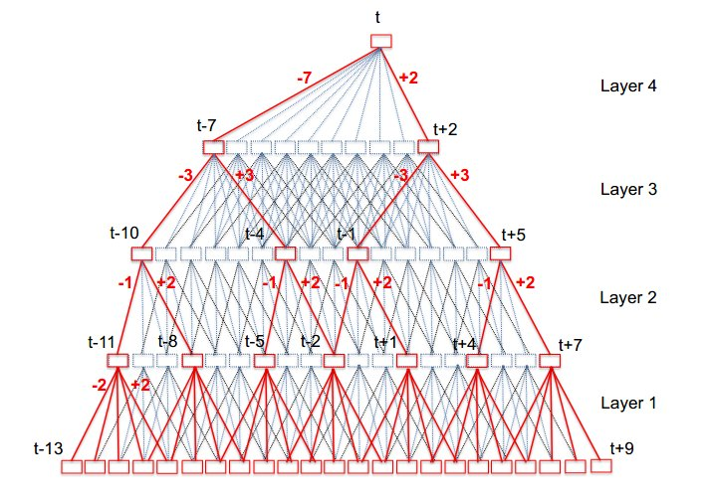
TDNN

Slide 4
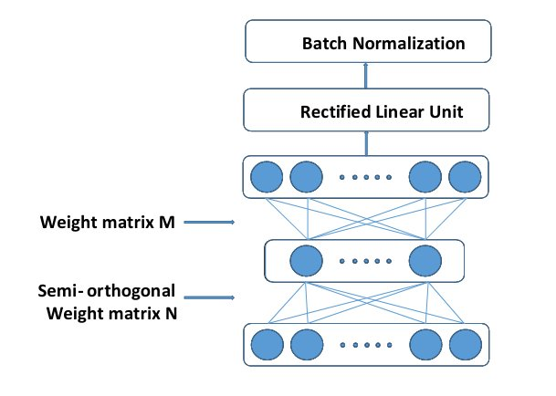
Factorized-TDNN (tdnnf)

Slide 5
TDNN Training - steps
local/chain/run_tdnn.sh
Parameters setup
i-vector extraction - local/nnet3/run_ivector_common.sh
helps the DNN learn to be robust to speaker and channel variations.
Do speed augmentation
Low-resolution MFCC and generate alignment
Do volume augmentation of the speed perturbed data and extract high resolution MFCCs
Train ivector model extract ivectors for all the volume perturbed data
[High-resolution + ivector] will be the input of TDNN model
Creating LM with chain-type topology
Get the alignments as lattices - using the log-res MFCCs
Build a tree
Define the TDNN architecture
Train the TDNN model
Decode using the trained TDNN model

Slide 6
Requirements from the previous sessions
Tri3 model for the alignment generation
‘data’ folder
Language model (data/lang_nosp)
All the audio files

Slide 7
MFCCs
High resolution MFCCs
40-dimensional high-resolution MFCC features
--num-mel-bins=40
--num-ceps=40
Low resolution MFCCs
20-dimensional high-resolution MFCC features
--num-mel-bins=23
--num-ceps=20

Slide 8
Ivector training
N. Dehak, P. Kenny, R. Dehak, P. Dumouchel, and P. Ouellet, “Front-end factor analysis for speaker verification,”IEEE Transactions on Audio, Speech, and Language Processing, vol.19, no. 4, pp. 788–798, 2011.
Mickael Rouvier, Benoit Favre, Speaker adaptation of DNN-based ASR with i-vectors: Does it actually adapt models to speakers, INTERSPEECH 2014
Guoguo Chen, Daniel Povey, Sanjeev Khudanpur, Reverberation robust acoustic modeling using i-vectors with time delay neural networks, INTERSPEECH 2015
What is ivector?
An i-vector is a mapping from a variable-length speech segment to a fixed-dimensional representation that captures speaker characteristics or recording device.
Originally this representation was developed for speaker recognition/verification.
Why ivector in ASR?
In ASR it is provides an additional input (along with the acoustic features, such as MFCCs) to the DNN acoustic models, that helps the DNN learn to be robust to speaker and channel variations.
Helps model performing speaker adaptation and also adaptation to acoustic conditions.

Slide 9
Steps to train ivector
Build a universal background model (UBM), actually a GMM with large diverse data
A large projection matrix that are learned in an unsupervised way to maximize the data likelihood.
The projection maps high-dimensional statistics from the UBM into a low-dimensional representation, known as an i-vector.
In Kaldi Script -
Do speed perturbation and then volume perturbation
Compute MFCCs
To LDA transform to reduce dimensionality and decorelate the data
Train UBM of 512 Gaussian
Train ivector
Extract ivectors for all the data (original + data augmentation)

Slide 10
Creating LM with chain-type topology
Get the alignments as lattices - using the log-res MFCCs
Build a tree

Slide 11
Define the TDNN network
Config file
num_targets=$(tree-info $tree_dir/tree |grep num-pdfs|awk '{print $2}')
input dim=100 name=ivector
input dim=40 name=input
Network architecture (number of layers)
dropout_schedule='0,0@0.20,0.5@0.50,0' [linearly interpolate between 0.50 and 0.20]
L2-regularize [different different types of layers]
num-chunk-per-minibatch=128,64
Learning rates [–initial-learning-rate=0.04 and –final-learning-rate=0.004]
Epoch - frame-subsampling-factor
Criterion -
Lattice-free maximum mutual information (LF-MMI) criterion
Instead of a frame-level objective, the log-probability of the correct phone sequence is used as the objective function
Dropout schedule

Slide 12
Run the model
Egs generation - frame-level randomization of the input
Training the net
feat.online-ivector-dir=$train_ivector_dir \
feat.cmvn-opts="--config=conf/online_cmvn.conf" \

Slide 13
A few important points -
Setting GPU in exclusive mode (nvidia-smi -c 3) and use the GPU for one job at a time.
You can change --use-gpu=wait to --use-gpu=yes to chain/train.py
CUDA_VISIBLE_DEVICES=0,1,2

